Slide 1
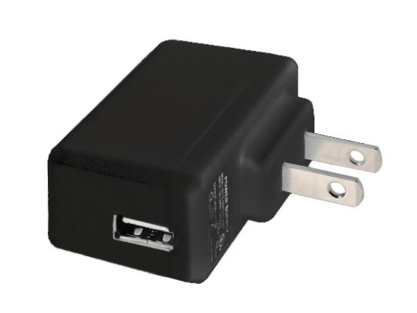
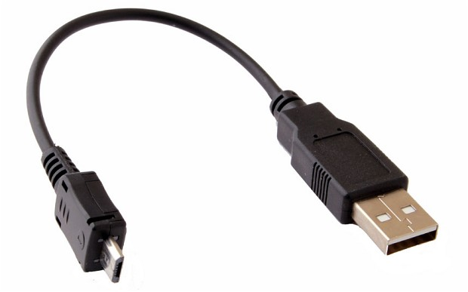
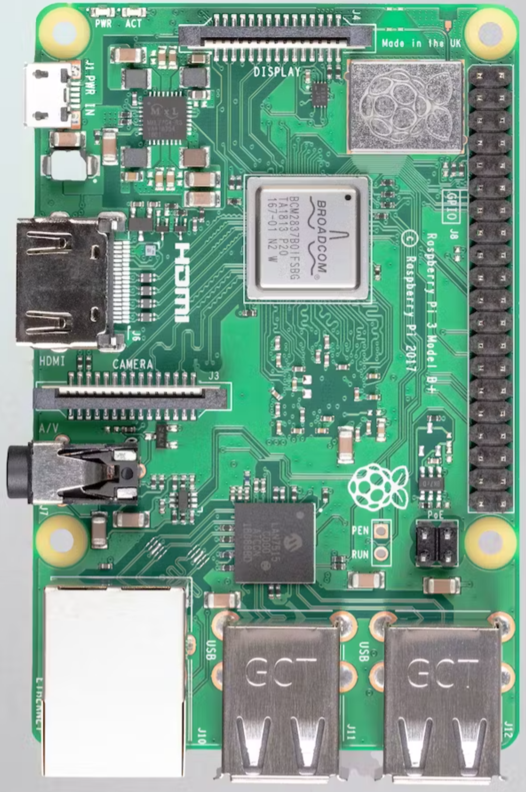
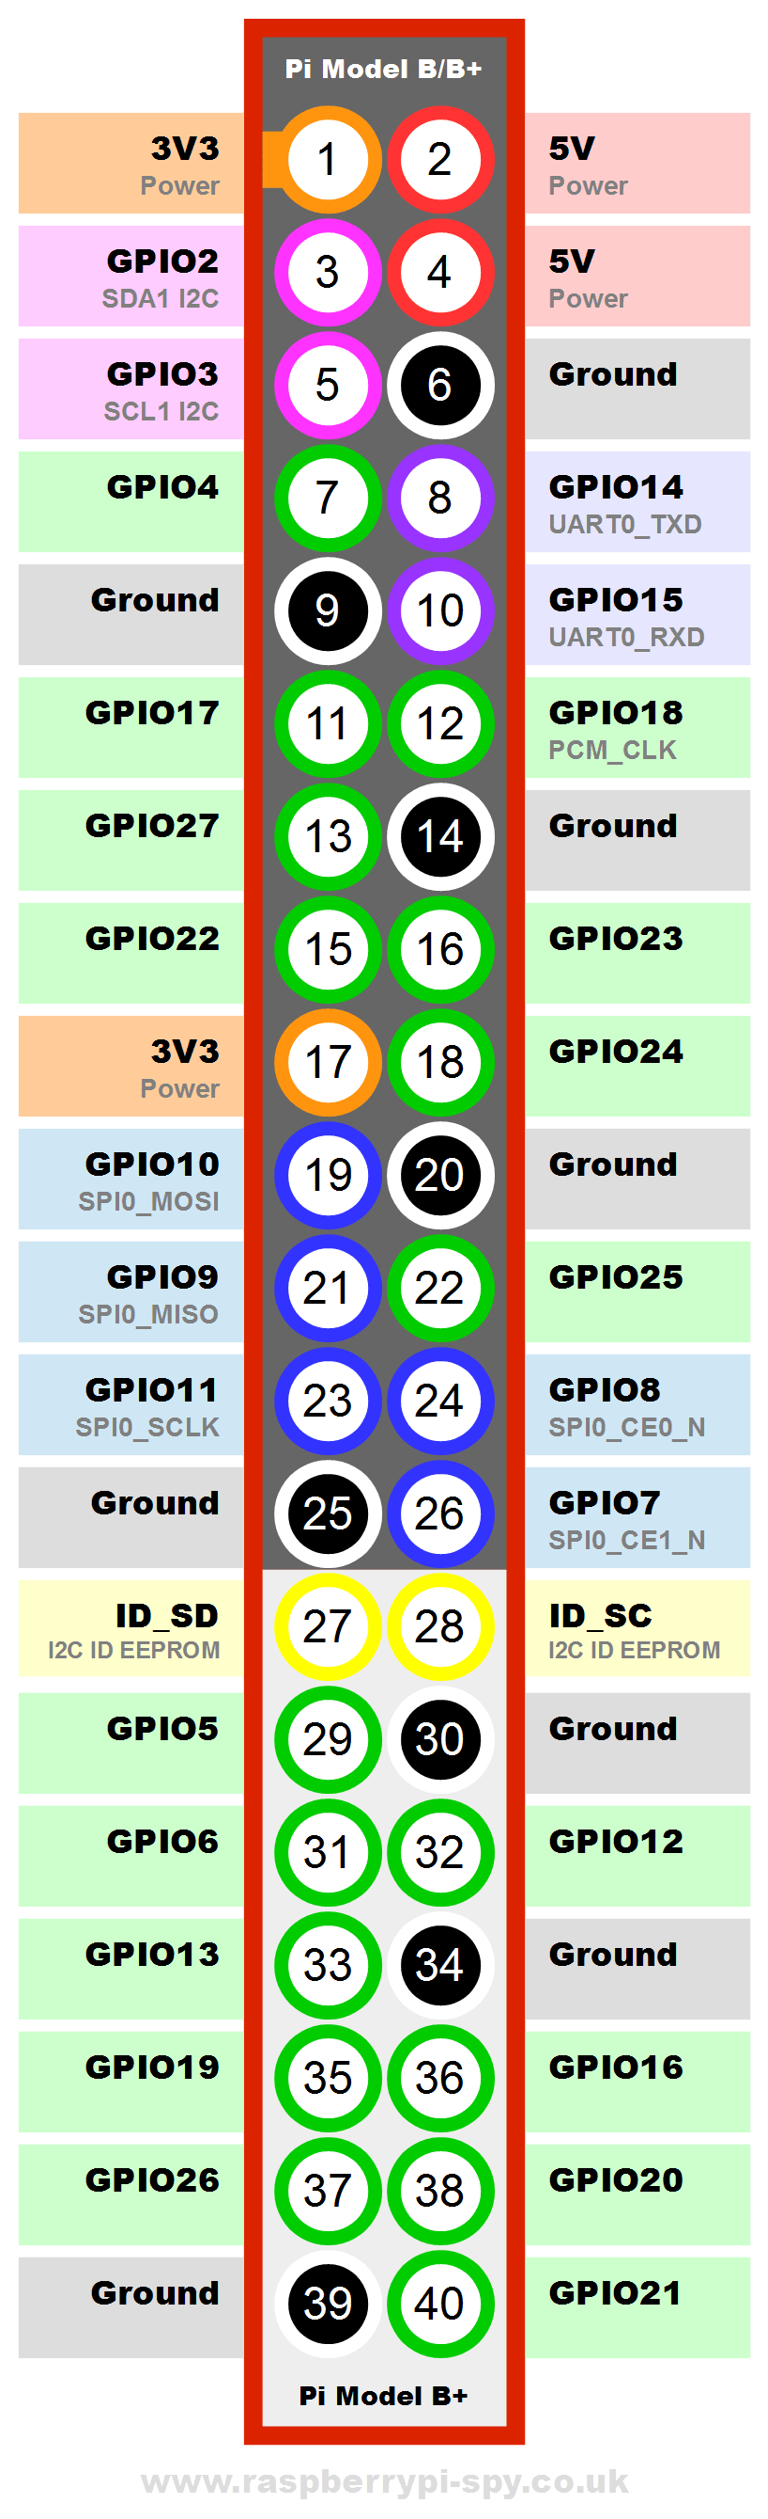
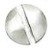
Door 1 – Magnet
Door 1 – Open Sensor
Door 1 – Closed Sensor
Door 2 – Open Sensor
Door 2 – Closed Sensor
Door 2 – Magnet

